Slide 1


Predicting Online Purchase Intention
Prof. Dr. Aloui Donia
•University of Tunis – Tunis Business School
Amel Borghol |BA/MRKT Imen Saad| BA/IT Ahed Telmoudi |BA/MRKT

Slide 2


PROBLEM STATEMENT
In e-commerce, a large proportion of website visitors leave without making a purchase. Understanding which sessions are likely to result in a purchase allows businesses to make smarter, data driven decisions across multiple areas:
  Real-Time Personalization
  Marketing Budget Allocation
  Customer Service Prioritization
  Inventory and Operational Planning
  Website Optimization

Slide 3

Research Objective:
The objective of this project is to apply supervised classification techniques to predict the binary target variable Revenue, which indicates whether a user session resulted in a completed purchase.
Research Questions:
  Can we accurately predict whether a session will result in a purchase?
  Which features are the strongest predictors of purchase intent?
  Which classification model performs best on this dataset, and why?

Slide 4
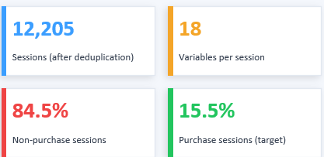

Dataset Description
What is the dataset?
The Online Shoppers Purchasing Intention Dataset captures real browsing sessions on an
e-commerce platform.
Each row is one visit, recording what pages were viewed, how long the user stayed, technical details, and whether the session ended in a purchase.
Source & Collection
Publicly available on the UCI Machine Learning Repository and Kaggle. Collected by researchers studying e-commerce user behavior.

Slide 5
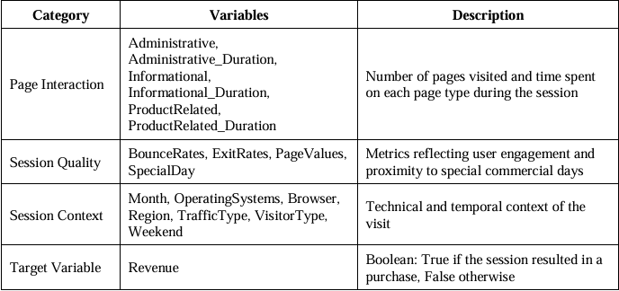
Dataset Description
Each observation represents one user session on the e-commerce website.
The 18 variables fall into four categories:

Slide 6
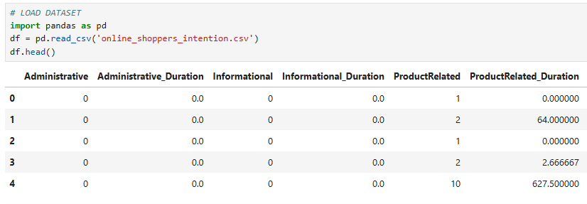
Data Preparation

Slide 7
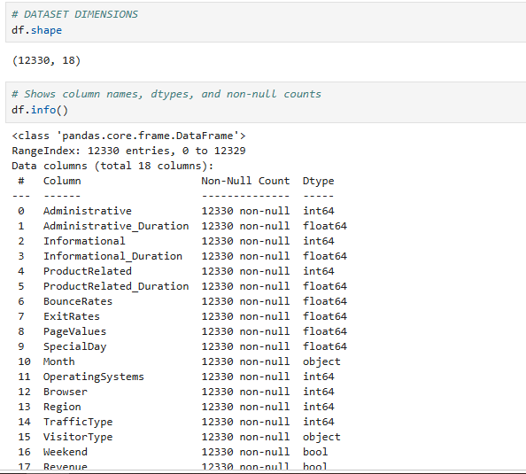
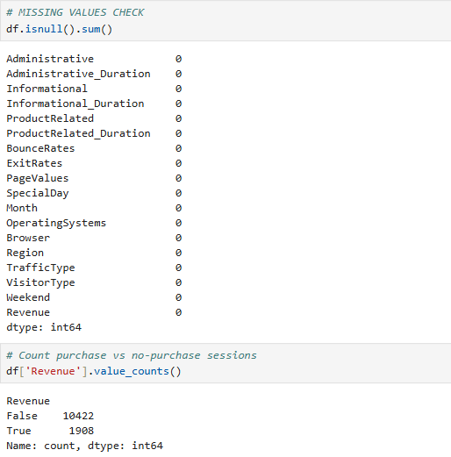
Data Preparation

Slide 8
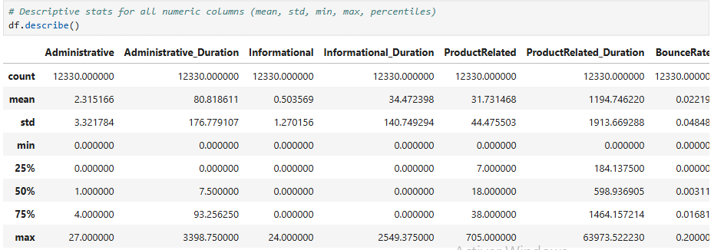
Data Preparation

Slide 9
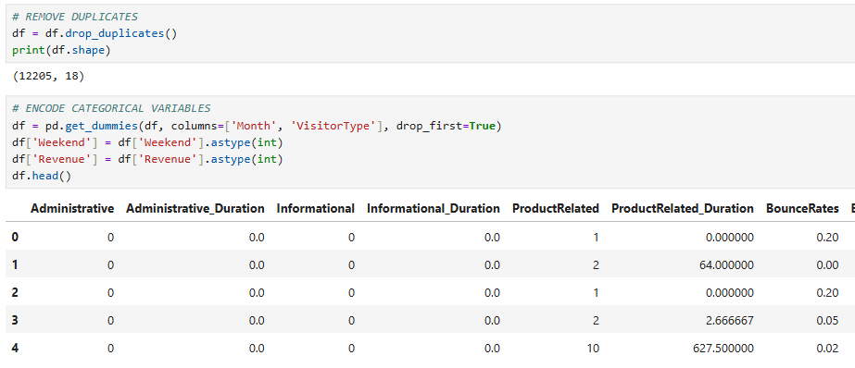
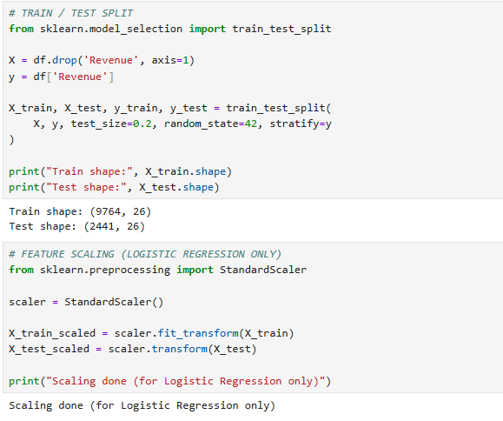
Data Preparation

Slide 10

Methods and Analysis
Model1:Logistic Regression
Why?
Model Limitations
  Binary classification: Purchase vs No Purchase
  Selected as a baseline model
  Used to compare with Decision Tree & Random Forest
  Simple and interpretable linear model
  Assumes linear relationship
  Cannot capture non-linear patterns

Slide 11

Model 2 — Decision Tree
Why?
Role in the Project
Model Configuration
  Captures non-linear relationships
  Handles complex feature interactions
  More flexible than Logistic Regression
  Suitable for behavioral data patterns
  max_depth = 10 (limits complexity)
  Prevents overfitting
  Trained on unscaled data
  Not sensitive to feature magnitude
  Acts as an intermediate model
  Between Logistic Regression (simple) and Random Forest (complex)
  Helps evaluate if a single tree is sufficient

Slide 12



Model 3 — Random Forest
Strengths for This Dataset
Why?
  Reduces overfitting of a single Decision Tree
  Combines multiple trees (ensemble model)
  Produces more stable & accurate predictions
  Uses majority voting
  Handles noisy & high-dimensional data
  Captures complex feature interactions
  Detects subtle patterns in purchase behavior
  More robust than linear & single-tree models
Model Configuration
Business Value
  n_estimators = 200 (more stability)
  max_depth = 10 (controls overfitting)
  Trained on unscaled data
  Not sensitive to feature magnitude
  Provides feature importance
  Identifies key drivers of purchase intent
  Adds interpretability for decision-making

Slide 13

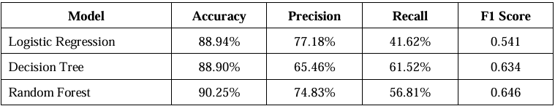

Model Performance Comparison
  Evaluation based on Accuracy, Precision, Recall, F1 Score

Slide 14




Model Performance Comparison
Random Forest
Decision Tree
Logistic Regression
⟶ Best Model: Random Forest
  Highest F1 Score (0.646)
  Best balance between Precision & Recall
  Strong overall performance & reliability

Slide 15
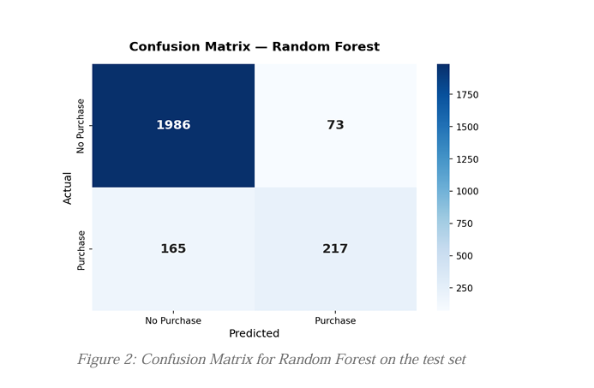
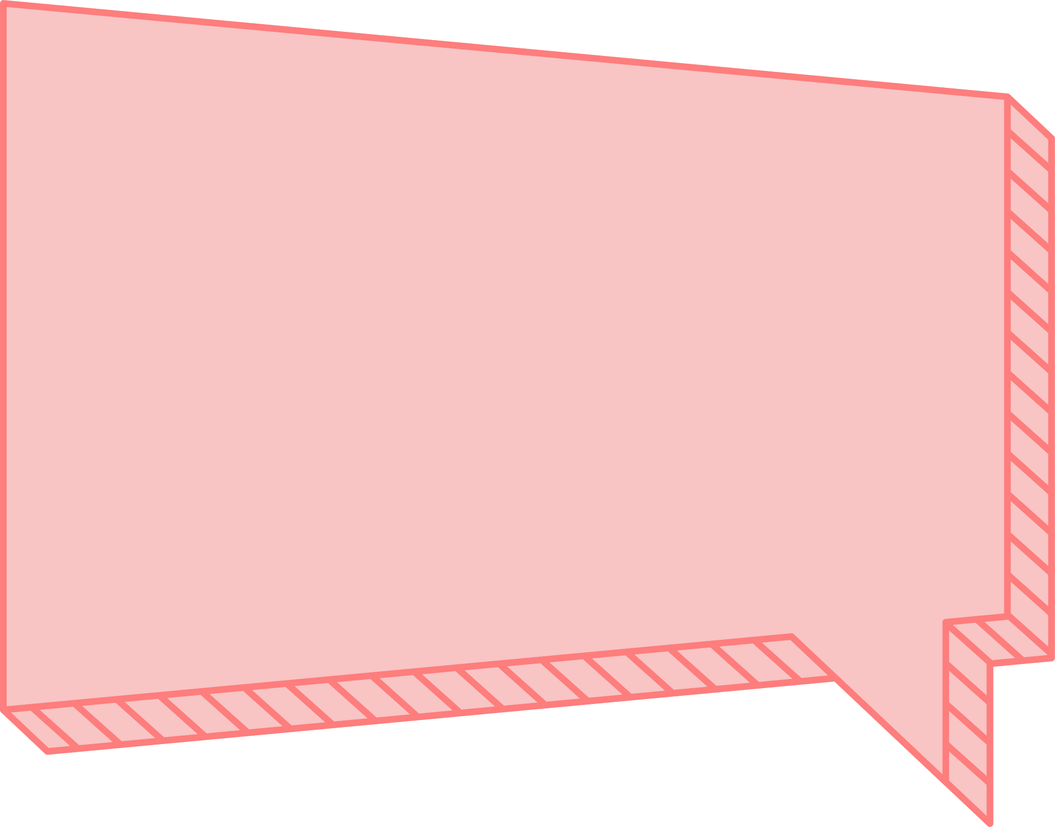
Confusion Matrix — Random Forest
This confusion matrix illustrates the performance of the Random Forest model on the test set.

Slide 16



Confusion Matrix — Random Forest
Model Performance Insights:
High True Negatives (1986) → strong detection of non-buyers
Good True Positives (217) → captures actual purchases
Low False Positives (73) → high precision
Some False Negatives (165) → missed buyers
Limitation: Missed purchases due to class imbalance

Slide 17
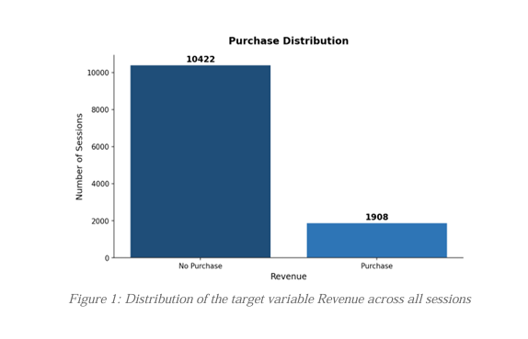
Purchase Distribution
  Majority of sessions result in no purchase (10,422)
  Only a small portion leads to purchase (1,908)
  Dataset is highly imbalanced (~84.5% vs 15%)
  Models may be biased toward predicting “no purchase”

Slide 18
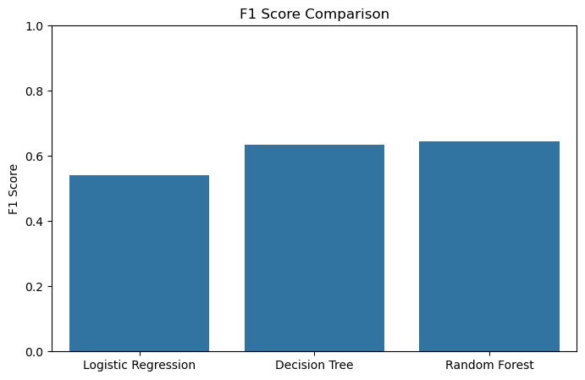
F1 Comparison
  Best metric for imbalanced classification
  Balances Precision and Recall
  More reliable than accuracy alone
  Random Forest achieves highest F1-score

Slide 19
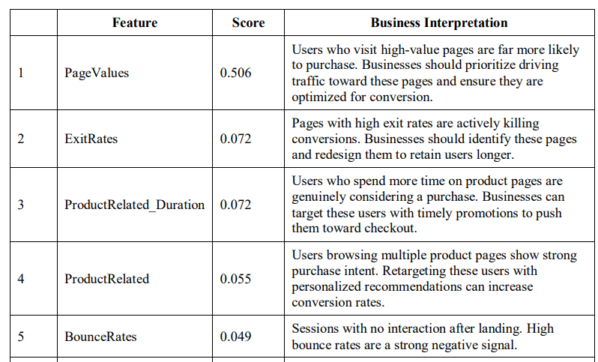
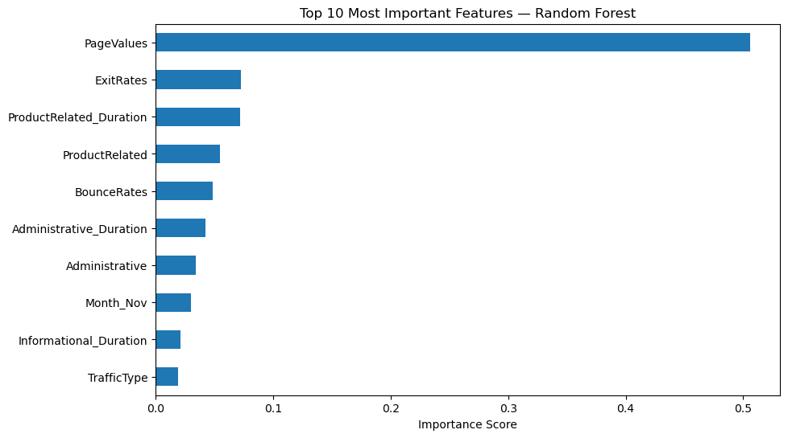
Feature Importance — Key Drivers
  Identifies most influential features
  Top features: PageValues, ExitRates, ProductRelated, etc.
  Helps understand customer behavior

Slide 20
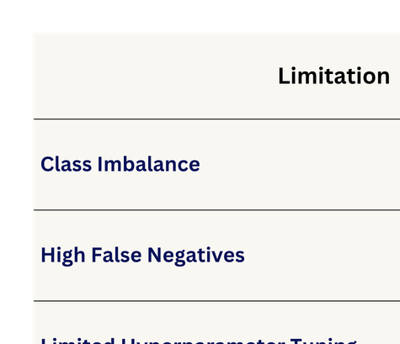

Limitations of the Modeling Approach
LIMITATIONS
DESCRIPTION

Slide 21

Summary & Conclusion
  End-to-end approach:
preprocessing → modeling → evaluation
  Comparative analysis of Logistic Regression, Decision Tree, and Random Forest
  Random Forest emerged as the most robust and consistent model
  Key behavioral factors influencing purchase were identified
  Approach supports data-driven decision-making in e-commerce
⟶ Turning data into insight is good, turning it into decisions is what creates impact.

Slide 22
FURTHER CODE EXPLANATION
⟶ run the model

Slide 23
THANK YOU
for your attention

